Slide 1
ALUMNI MANAGEMENT SYSTEM
Presented by :
Pallabothula Susmitha
Sammingi Pushpa Nandini
Sanapathi Sireesha
Gurram Sirisha
Pavuluri Ramadevi

Slide 2
Introduction
The Alumni Management System is a simple C project in which a university can keep track with its students and graduates.
Students can view their profile and alumni can create job information.
The project manages the fresh as well as old graduate students with their respective information in actively participating in registering, searching and managing resources.

Slide 3
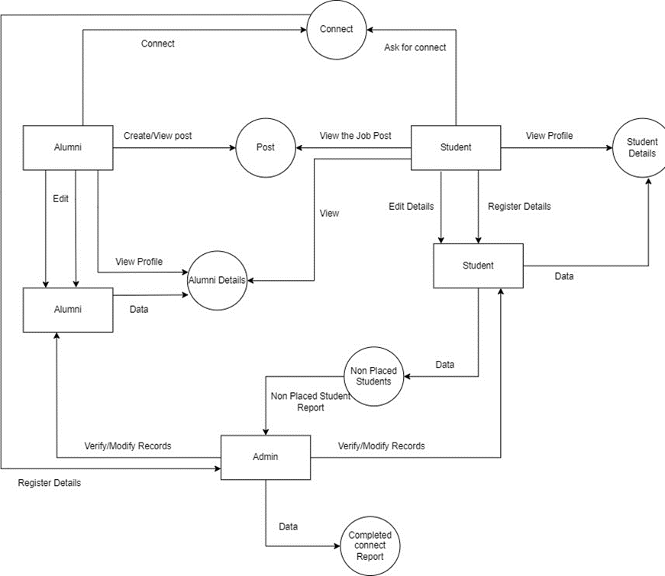
Architecture

Slide 4

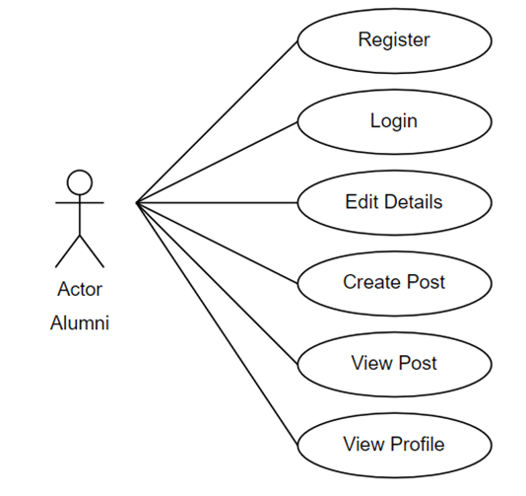
Architecture For Alumni
An Alumni can first register by entering his personal and professional details.
Once registered the alumni can login to his page and post the job-related contents for the other users to see.

Slide 5
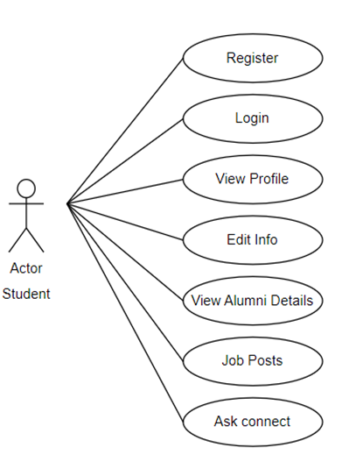
Architecture For Student
A student can register into the portal. If the student already has his login credentials .
Student can go into the portal and view all the information posted by alumni.

Slide 6
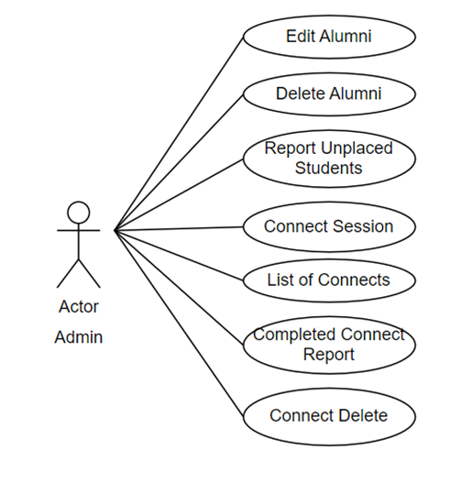
Architecture For Admin
Admin can login using a password and can modify, delete, view records of alumni database and student database.
Generates the report for unplaced students.

Slide 7
Tools
Ubuntu Linux as platform.
C language.
Draw io is used for pictorial representations.
Makefile is use for compilation.
Gcov is used to check code coverage.
Valgrind to find memory leaks.
Splint is used for static analysis.
GCC is an optimizing compiler.

Slide 8
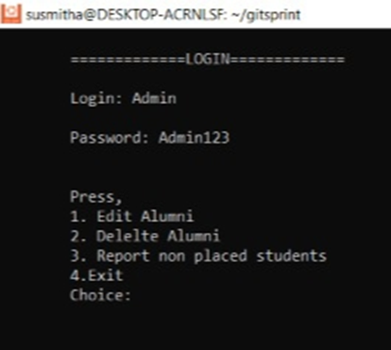
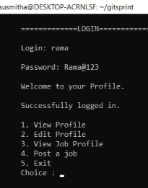
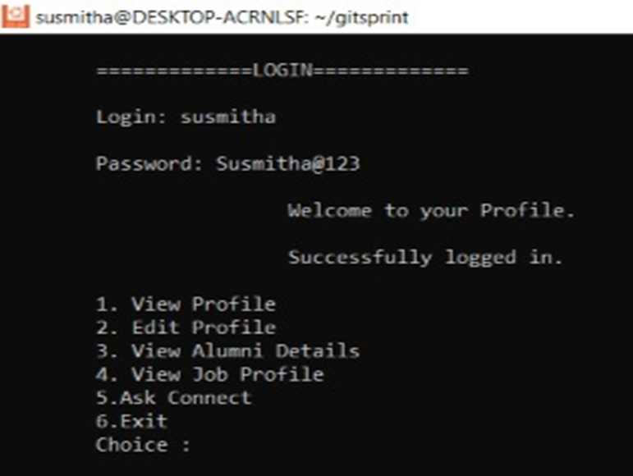
Login Output

Slide 9
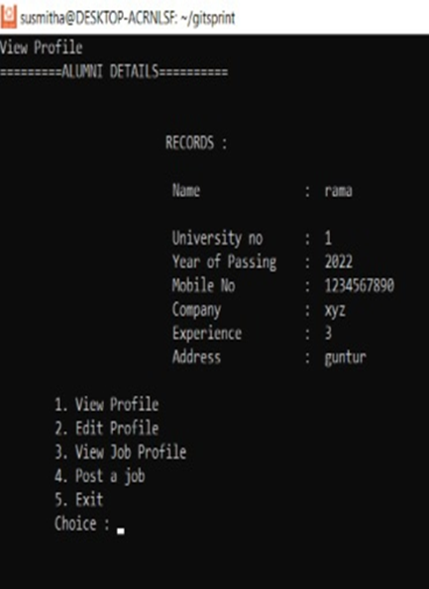
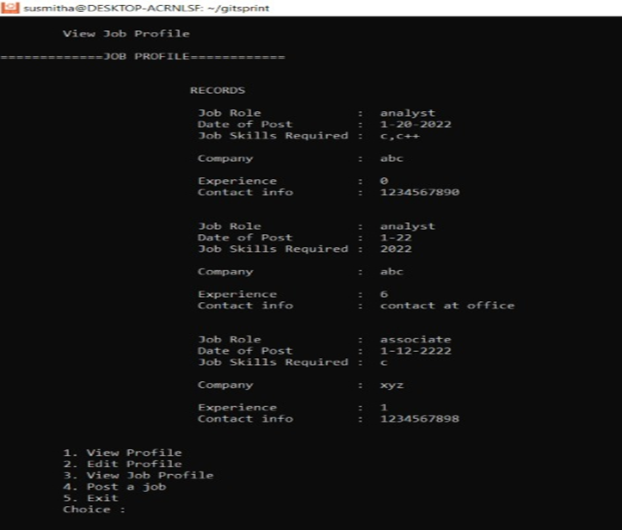
Output View Profile

Slide 10
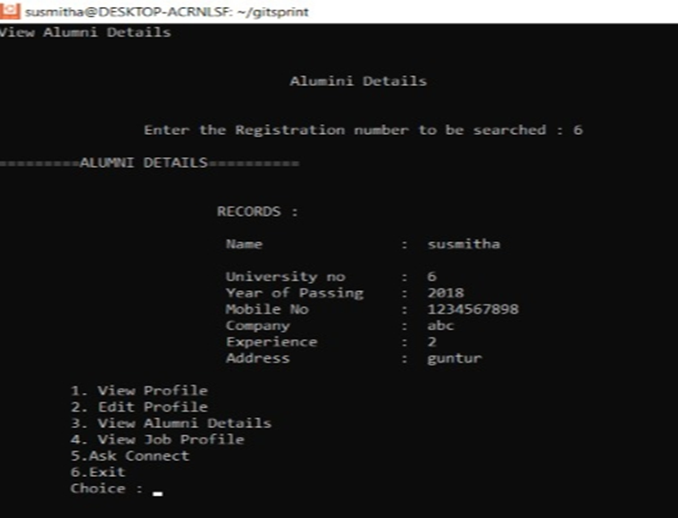
Output View Details

Slide 11
Challenges
Pallabothula Susmitha: Coding , Tools.
Sammingi Pushpa Nandini: Design document, PPT, Tools.
Sanapathi Sireesha: UT_IT test cases, Coding.
Gurram Sirisha: SRS, Negative test cases.
Pavuluri Ramadevi: UT_IT test cases, document.

Slide 12
Thank You

